Slide 1
Predicting Ransomware patterns in a
BitCoin graph
Shannon R. Serrao
Seasonal variation of Ransomware families
Github repo

Slide 2
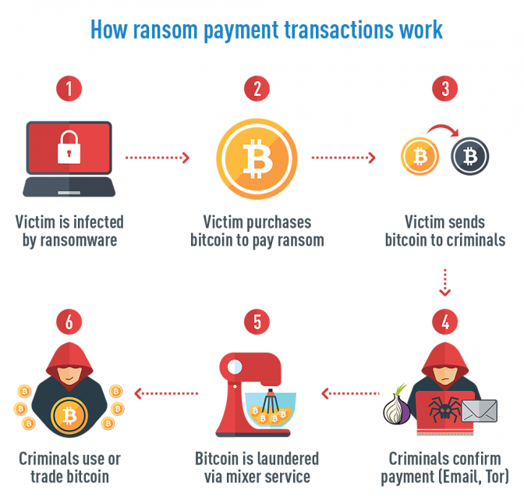
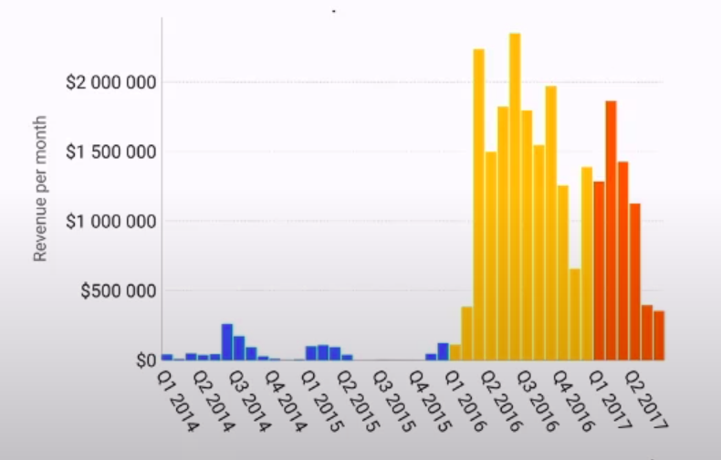
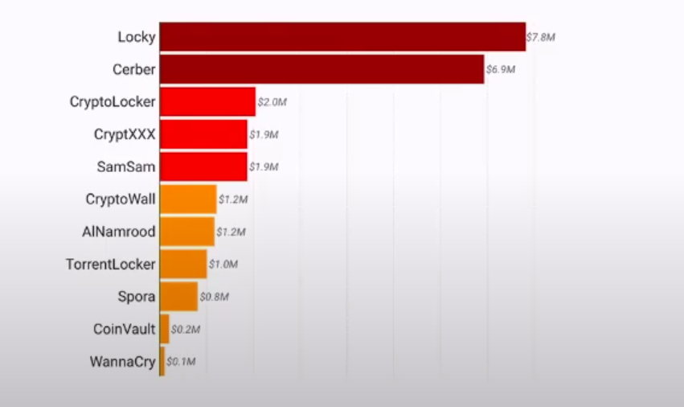
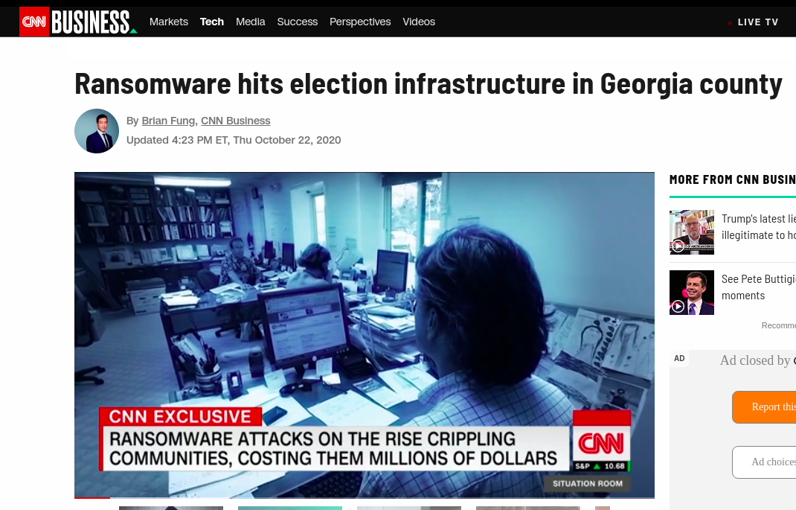
What is Ransomware ?

Slide 3
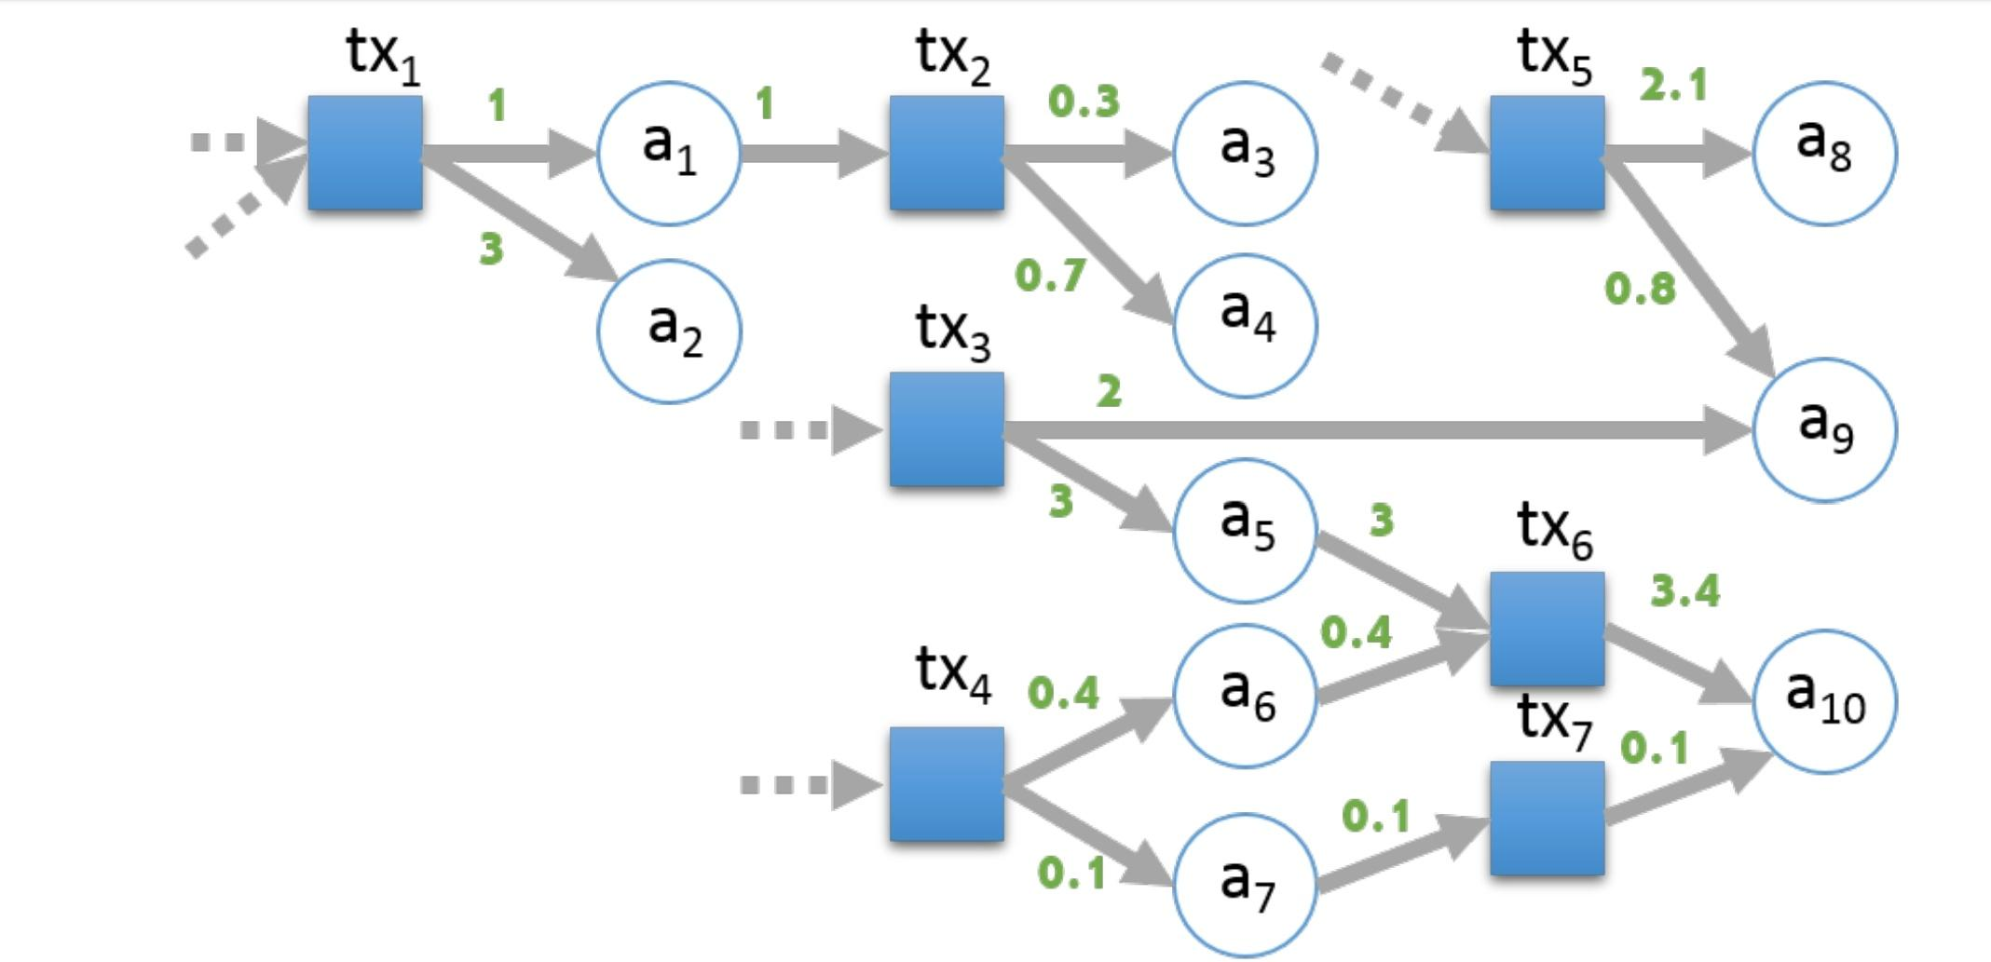
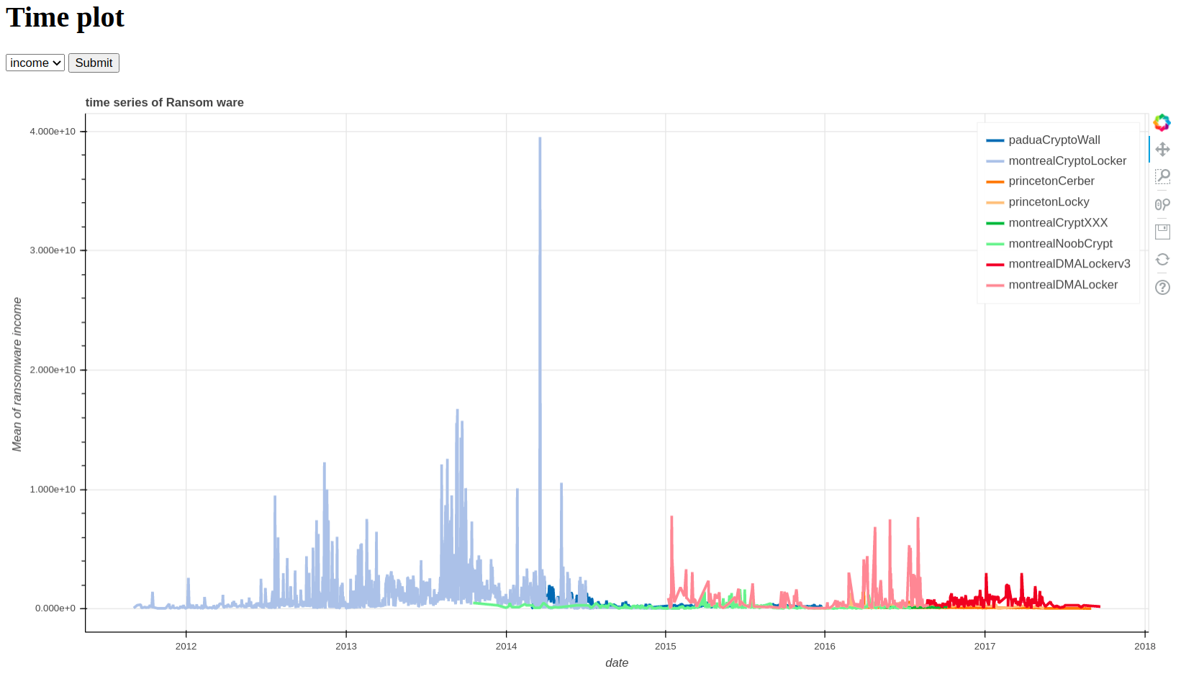
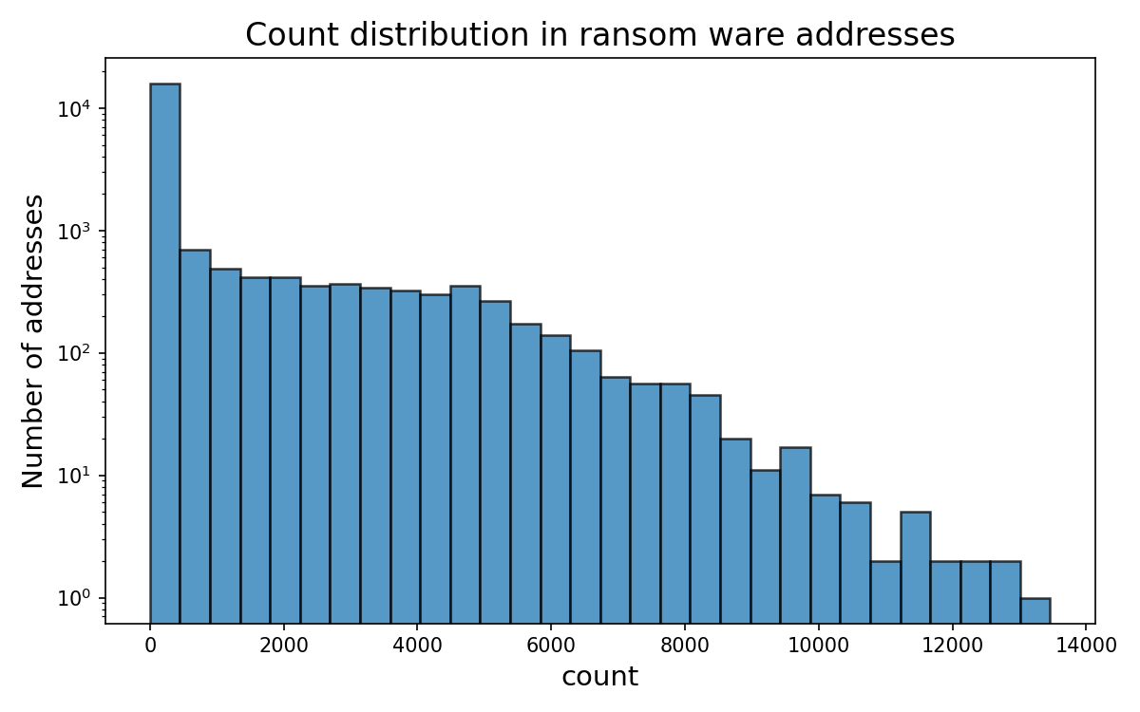
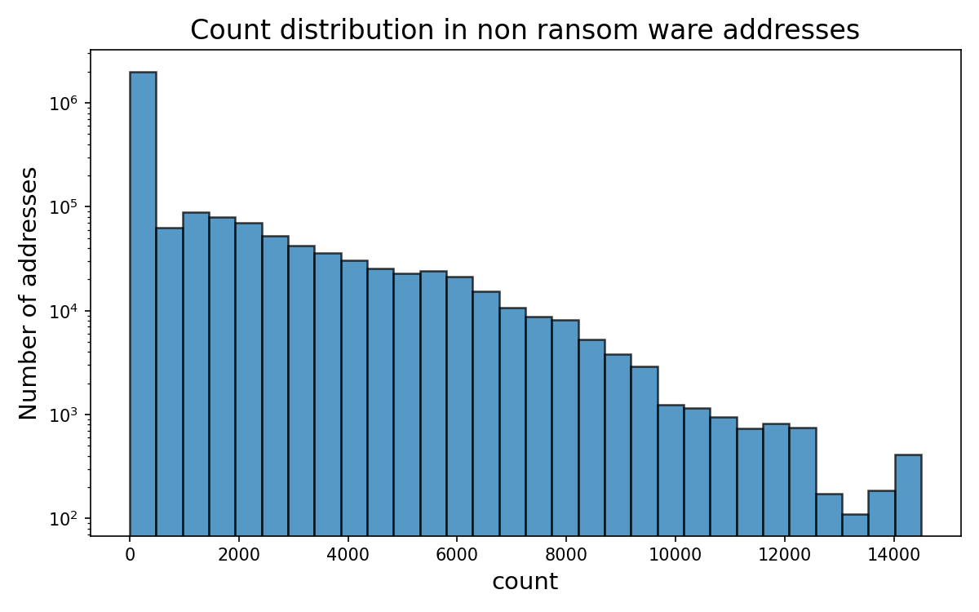
Tracking Ransomware on a Blockchain
Features
Count
Length
Income
Count
Weight
Neighbors
Dynamic activity of Ransomware transactions
Heroku app: Seasonal variation of Ransomware families
Skewness of the ransomware features

Slide 4
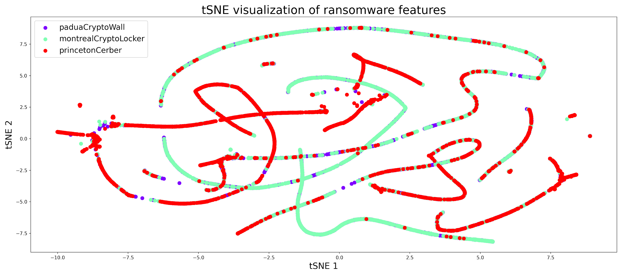
Ransomware clusters using tSNE
Important takeaways
Clusters of Ransomware firms that separate from non ransomware. Few-shot learning using Topological data analysis can enable us to detect patterns quickly.
Feature extraction, data selection, date time formatting, clustering and dimensionality reduction.
Ransomware features different at a global scale but these difference are magnified when looking at the dynamic patterns
Future goals: 1. (Current) Classify new/existing ransomware families from past features and predictions.
2. Implement the few shot transaction pattern learning, which uses meta-learning paradigm.
3. Make it dynamic and scalable using live data.
Notes:
perplexity

